Slide 1
CHATGPT: LOVE OR HATE?
by JAYAWARDANA Wickramasinghe Pathiranage Lakindu Ransika (3036094631)
really long name lol

Slide 2
The Main Highlights
1
3
2
4
Research Questions
Major Takeaways
Data Pipeline
Future and Limitations

Slide 3
Research Questions
What emotions are associated with GPTs?
What words are used to convey these emotions?

Slide 4
Why are these questions important?

Slide 5
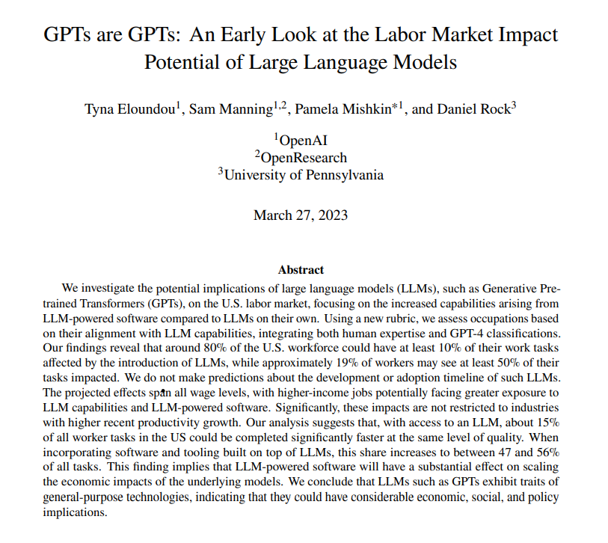
glad I attended that lecture lol

Slide 6
80% of the US workforce is predicted to be affected

Slide 7
THAT’S A LOT!
80% of this project too lol

Slide 8
Data Pipeline

Slide 9
Now let’s reduce 80% of our work by using Chatgpt lol

Slide 10
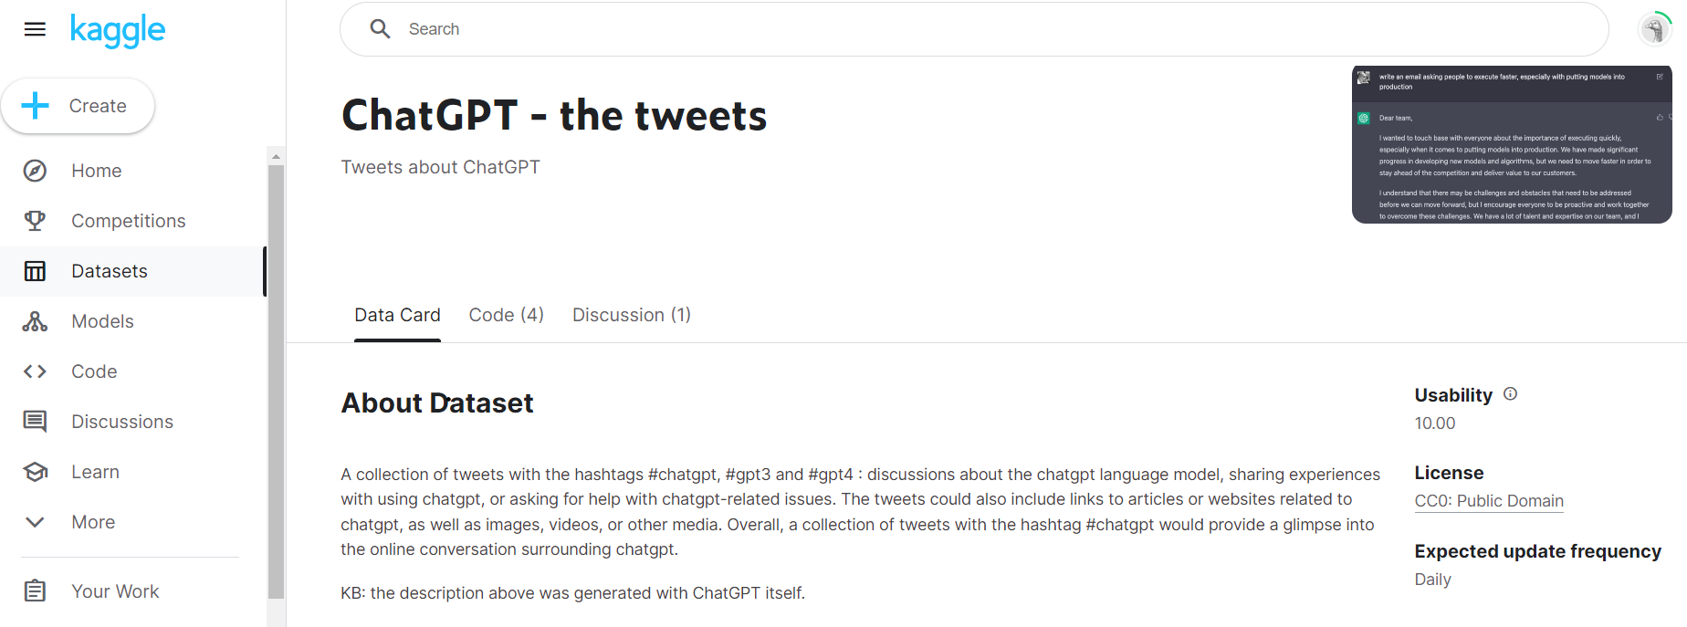

Data Collection (updated 25th April)

Slide 11
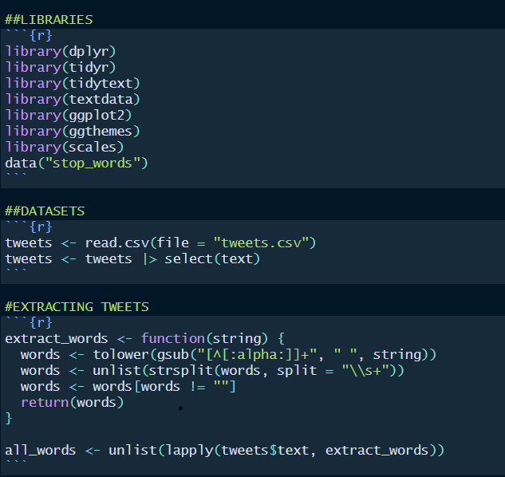
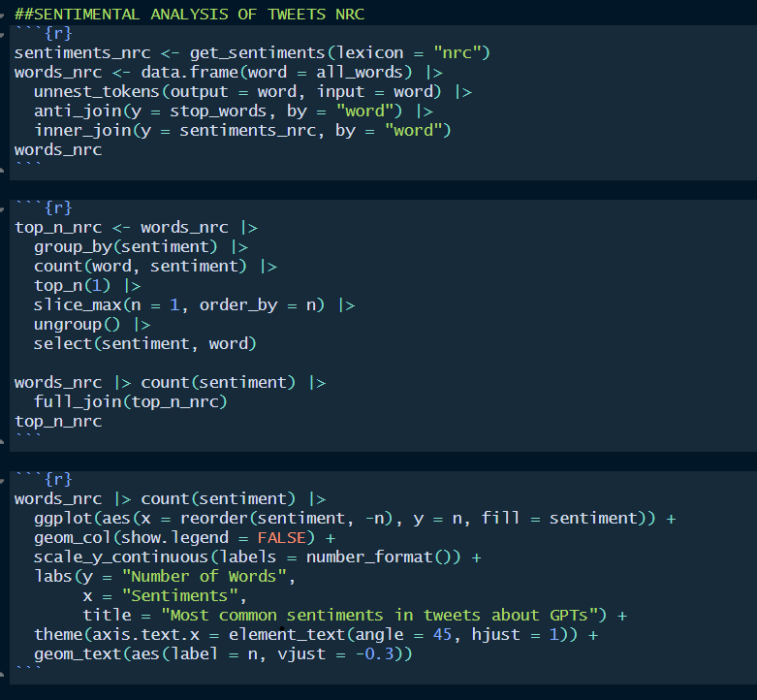
Data Wrangling and Visualisation

Slide 12
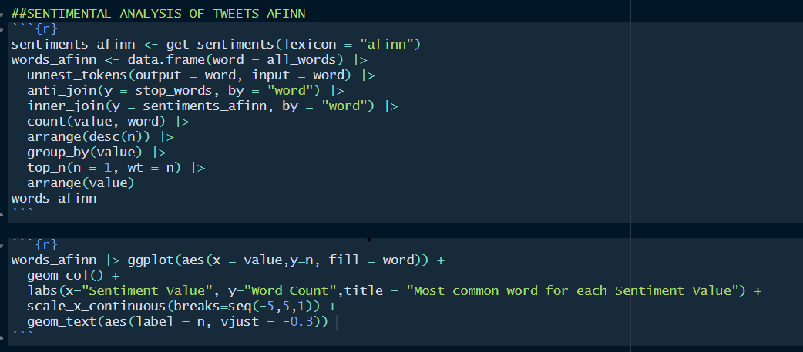
Data Wrangling and Visualisation

Slide 13
Major Takeaways

Slide 14
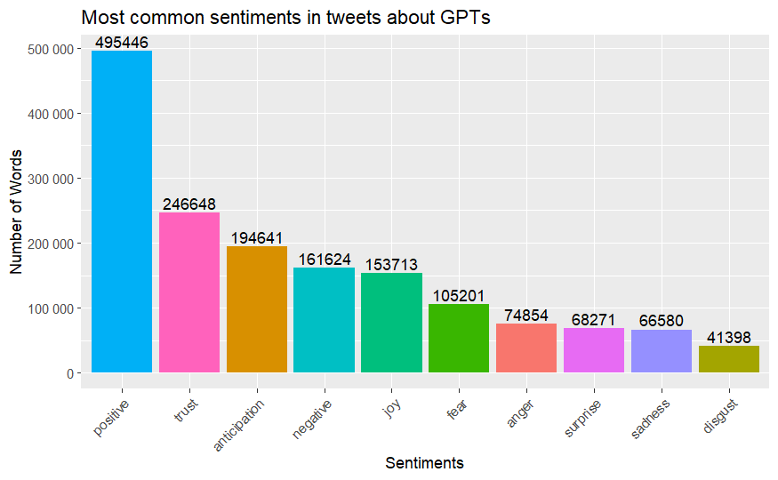
NRC
Mostly associated with a positive sentiment
The top 3 sentiments being;
Trust
Anticipation
Joy
We could infer that;
People trust GPTs
People anticipate for more advancements
People are happy about GPTs

Slide 15
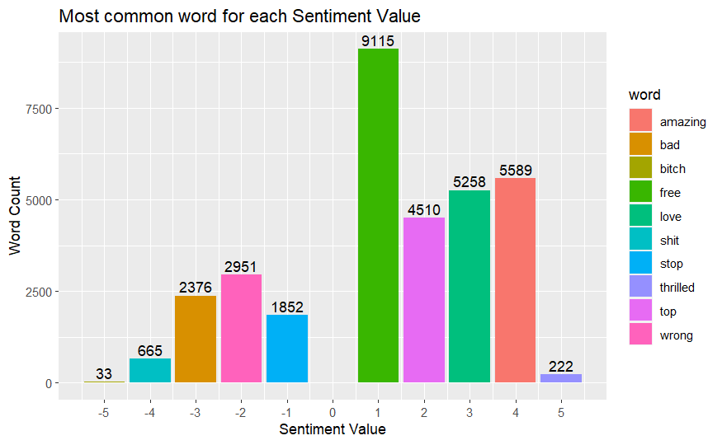
AFINN
Mostly associated with a positive sentiment
Most common positive words being;
Free
Amazing
Love
We could infer that;
People love the fact that it is free
People think it’s useful
‘Wrong’: Possibility to make incorrect statements

Slide 16
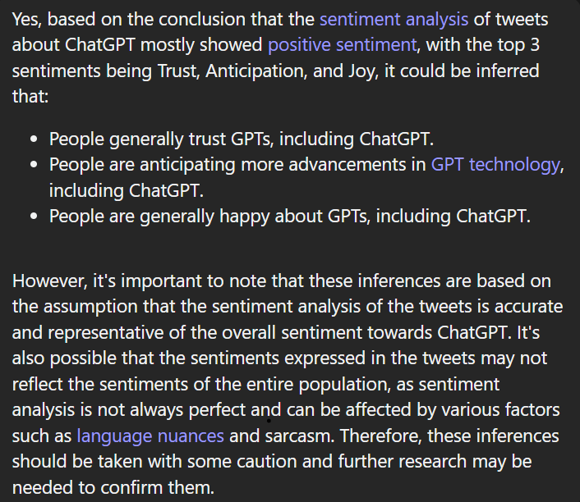
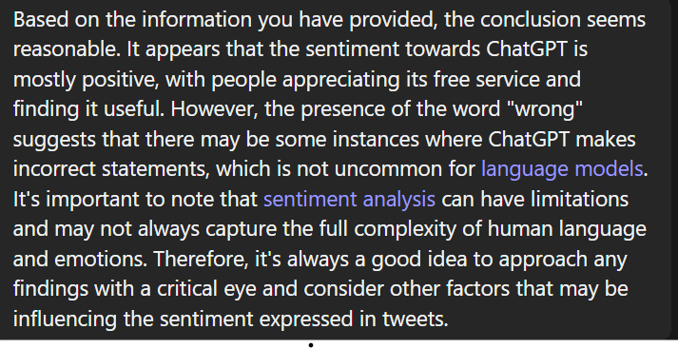
What does Chatgpt think of this?
Graph 2
Graph 1
Notes:
Summary: human language and emotion are really complex. Sentiment analysis might miss language nuances like sarcasm

Slide 17
Future and Limitations
Future
Expand to more social media platforms and offline surveys to diversify population.
Research on how these “sentiments” have changed across time.
Examine tweets with “most common words” to get a better understanding of the context.
Research on how “user location” affects these sentiments
Limitations
Sentiment analysis does not account for language nuance such as sarcasm
Human emotion are really complex
Population bias: Twitter might have a more positive outlook on GPTs since it’s online
Participation bias: People are more likely to report when something is negative (Graph 2 ‘Wrong’)

Slide 18
Thanks!
Please keep this slide for attribution

Slide 19
References
Eloundou, Tyna, Sam Manning, Pamela Mishkin, and Daniel Rock. “GPTs Are Gpts: An Early Look at the Labor Market Impact Potential of Large Language Models.” arXiv.org, March 23, 2023. https://arxiv.org/pdf/2303.10130.pdf.
Banachewicz, Konrad. “Chatgpt - the Tweets.” Kaggle, April 24, 2023. https://www.kaggle.com/datasets/konradb/chatgpt-the-tweets.

